Slide 1


Date
Mar 10, 2025
RevoGrocers
Sales Performance Analysis
by
Batch
Assignment
Linkedin
Ahmad Rizki
RevoU FSDA batch FEB25
Intermediate
SQL
www.linkedin.com/in/arizabdulhanan

Slide 2
Business Overview & Disclaimer
Company Overview
RevoGrocers is a fictional grocery retail business that operates across multiple locations, providing a wide range of grocery products to customers.
The company aims to optimize sales strategies, improve customer experience, and maximize revenue using data-driven insights.

Slide 3
Business Overview & Disclaimer
Disclaimer
This analysis is based on a public dataset from Kaggle.
RevoGrocers is a fictional company created for analytical purposes.
Any insights or recommendations are based on this dataset and do not reflect real-world data.
The queries and insights generated in this assignment should be personalized to your own analysis results.

Slide 4
Business Overview & Disclaimer
Dataset Overview
Key Tables Used : sales (transactional data) products (product details) categories (product category information) | Relevant Fields : CategoryID (number of category ID) CategoryName (product category) ProductID (number of product ID) Price (unit price) Quantity (units sold) Discount (discount percentage of transaction) CustomerID (number of customer ID) SalesID (number of sales ID)

Slide 5
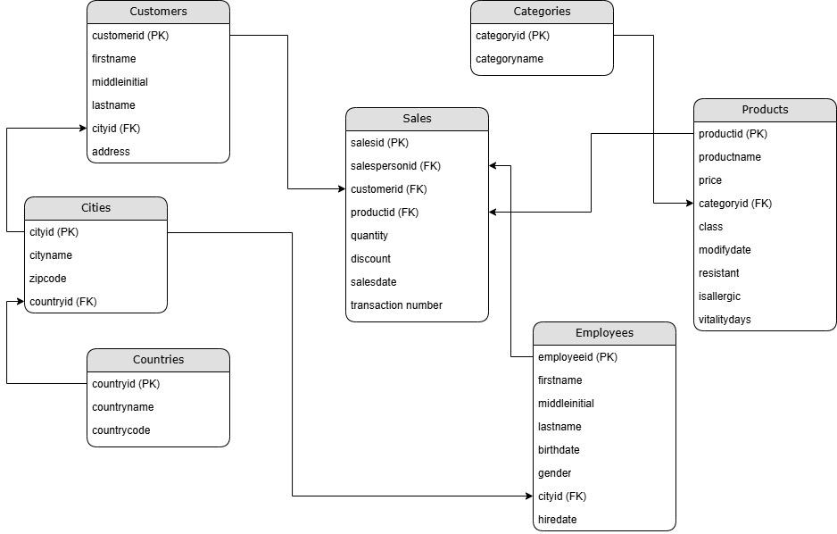
Business Overview & Disclaimer
ERD

Slide 6
Business Overview & Disclaimer
Project Goal
Identify top-performing product categories.
Analyze factors driving revenue (units sold vs customer count).
Evaluate pricing strategies and their impact on sales.

Slide 7
Methodology
Approach Taken
Data cleaning and transformation using SQL (BigQuery).
Breakdown of analysis into five key business insights.
Tools : Google BigQuery - for running SQL queries and analyzing structured datasets
Key SQL Queries
For each analysis, include :
Query Explanation
Formatted SQL Query
Screenshot of Query Output

Slide 8

Confections Lead Revenue with Over $556M – Opportunity for Expansion and Targeted Promotions
Query
SELECT
categories.categoryname
, SUM(products.price * sales.quantity * (1 - sales.discount)) AS `Total Revenue`
FROM
`fsda-sql-01.grocery_dataset.sales` AS sales
JOIN
`fsda-sql-01.grocery_dataset.products` AS products
ON sales.productid = products.productid
join
`fsda-sql-01.grocery_dataset.categories` AS categories
ON products.categoryid = categories.categoryid
GROUP BY
categories.categoryname
ORDER BY
2 DESC
limit 1;

Slide 9
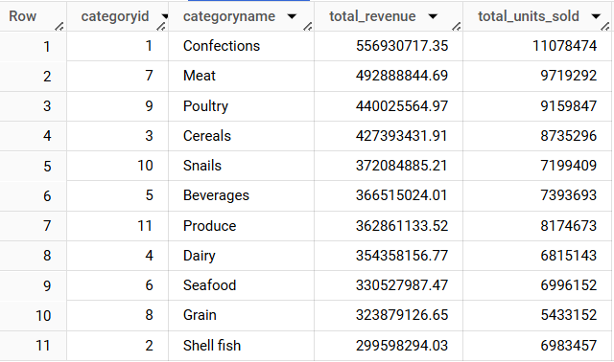
Revenue and Units Sold Show Strong Positive Correlation Across All Categories
Query
SELECT
categories.categoryid
, categories.categoryname
, round((SUM(products.price * sales.quantity * (1 - sales.discount))), 2) AS total_revenue
, SUM(sales.quantity) AS total_units_sold
FROM
`fsda-sql-01.grocery_dataset.sales` AS sales
JOIN
`fsda-sql-01.grocery_dataset.products` AS products
ON sales.productid = products.productid
JOIN
`fsda-sql-01.grocery_dataset.categories` AS categories
ON products.categoryid = categories.categoryid
WHERE sales.productid != 452
GROUP BY
categories.categoryid, categories.categoryname
order by 3 desc;

Slide 10
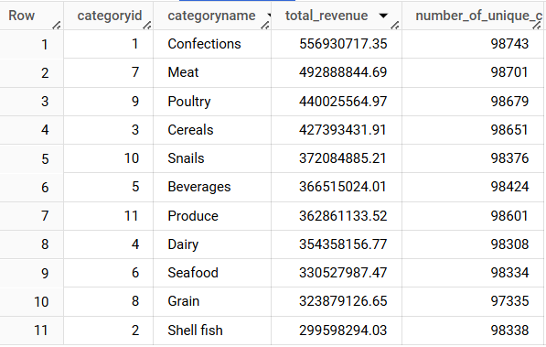
Positive Correlation Between Revenue and Unique Customers in Most Categories, Except Confections and Shellfish
Query
SELECT
categories.categoryid
, categories.categoryname
, round(SUM(products.price * sales.quantity * (1 - sales.discount)), 2) AS total_revenue
, COUNT(DISTINCT sales.customerid) AS number_of_unique_customers
FROM
`fsda-sql-01.grocery_dataset.sales` AS sales
JOIN
`fsda-sql-01.grocery_dataset.products` AS products
ON sales.productid = products.productid
JOIN
`fsda-sql-01.grocery_dataset.categories` AS categories
ON products.categoryid = categories.categoryid
WHERE sales.productid != 452
GROUP BY
categories.categoryid, categories.categoryname
order by 3 desc;

Slide 11
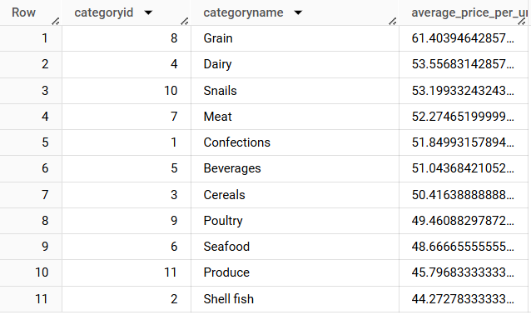
Grain Has Highest Average Unit Price, While Shellfish Has the Lowest
Query
select
categories.categoryid
, categories.categoryname
, avg(products.price) average_price_per_unit
from `fsda-sql-01.grocery_dataset.products` products
join
`fsda-sql-01.grocery_dataset.categories` categories
ON products.categoryid = categories.categoryid
where categories.categoryid is not null --categoryid and price for productid 452 is null
group by 1, 2
order by 3 desc;

Slide 12
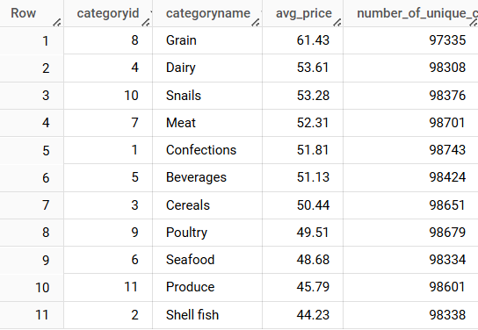
Higher Prices Linked to More Customers in Most Categories, Except Confections and Shellfish
Query
SELECT
categories.categoryid
, categories.categoryname
, round(AVG(products.price), 2) AS avg_price
, COUNT(DISTINCT sales.customerid) AS number_of_unique_customers
FROM
`fsda-sql-01.grocery_dataset.sales` AS sales
JOIN
`fsda-sql-01.grocery_dataset.products` AS products
ON sales.productid = products.productid
JOIN
`fsda-sql-01.grocery_dataset.categories` AS categories
ON products.categoryid = categories.categoryid
WHERE sales.productid != 452
GROUP BY
categories.categoryid, categories.categoryname
order by 3 desc;

Slide 13
Confections Remain Top Revenue Contributor with 12.87% Share
Query
SELECT
categories.categoryid
, categories.categoryname
, round(SUM(products.price * sales.quantity * (1 - sales.discount)), 2) total_revenue
, round(((SUM(products.price * sales.quantity * (1 - sales.discount)) /
(SUM(SUM(products.price * sales.quantity * (1 - sales.discount)))
OVER ())) * 100), 2) AS total_revenue_percentage
, rank() over (order by SUM(products.price * sales.quantity * (1 - sales.discount)) desc) rank
FROM
`fsda-sql-01.grocery_dataset.sales` AS sales
JOIN
`fsda-sql-01.grocery_dataset.products` AS products
ON sales.productid = products.productid
JOIN
`fsda-sql-01.grocery_dataset.categories` AS categories
ON products.categoryid = categories.categoryid
GROUP BY categories.categoryid, categories.categoryname
ORDER BY total_revenue_percentage DESC;

Slide 14
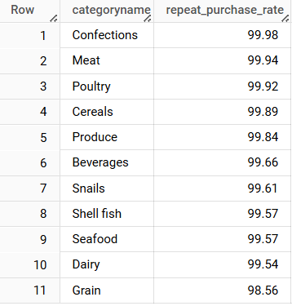
Confections Lead in Repeat Purchases; All Categories Maintain Over 98.5% Rate
Query
select
categories.categoryname
, round((COUNT(DISTINCT sales.customerid) /
(SELECT count(distinct customerid)
FROM
`fsda-sql-01.grocery_dataset.sales` sales
where productid is not null) * 100), 2) AS repeat_purchase_rate
from
`fsda-sql-01.grocery_dataset.sales` AS sales
JOIN
`fsda-sql-01.grocery_dataset.products` AS products
ON sales.productid = products.productid
JOIN
`fsda-sql-01.grocery_dataset.categories` AS categories
ON products.categoryid = categories.categoryid
group by categories.categoryname
having count(sales.CustomerID) > 1
order by 2 desc;

Slide 15
Insights
Confections contributed $556.9M or 12.87% of total revenue. Indicates high customer demand and loyalty.
Grain has the highest average price per unit, bringing strong revenue despite fewer units sold. And also has the strongest correlation between revenue and units sold. But, low in repeat purchase rate, suggesting a need to increase engagement for regular buying.
Beverages has performs well in attracting new customers and positive price-to-customer correlation shows loyalty even with price increases.
Shellfish has the lowest unit price, contributing to lower revenue which shows negative price-to-customer correlation – price increases may deter customers. It indicates shellfish relies on repeat buyers rather than attracting new ones.
Produce has low in both sales volume and revenue. And also the weakest correlations, possibly due to quality, pricing, or engagement issues.
Most categories show positive correlation between revenue, unit sales, and unique customers, except for Confections and Shellfish, which rely on loyal repeat customers rather than attracting new ones.

Slide 16
Recommendations
Grain
Introduce subscription models, loyalty programs, or bulk-buy discounts; Offer bundle deals or slightly lower prices to improve value perception and purchase frequency.
Confections
Launch seasonal products (e.g., holiday treats); Use "buy more, save more" or BOGO (Buy One, Get One) promotions; Emphasize cross-selling and upselling to repeat customers.
Shellfish
Introduce premium product lines (e.g., sustainably sourced) at higher prices; Encourage upselling through value bundles or discounts on bulk purchases.
Beverages
Run first-time buyer offers, “buy one, get one free”, and social media campaigns; Test small price increases, as customer loyalty is strong.
Produce
Evaluate product quality, pricing, and promotion strategy; Consider customer feedback surveys to uncover pain points.

Slide 17
Date
Mar 10, 2025
Thank You
For Your Attention…
by
Batch
Assignment
Linkedin
Ahmad Rizki
RevoU FSDA batch FEB25
Intermediate
SQL
www.linkedin.com/in/arizabdulhanan

